Slide 1
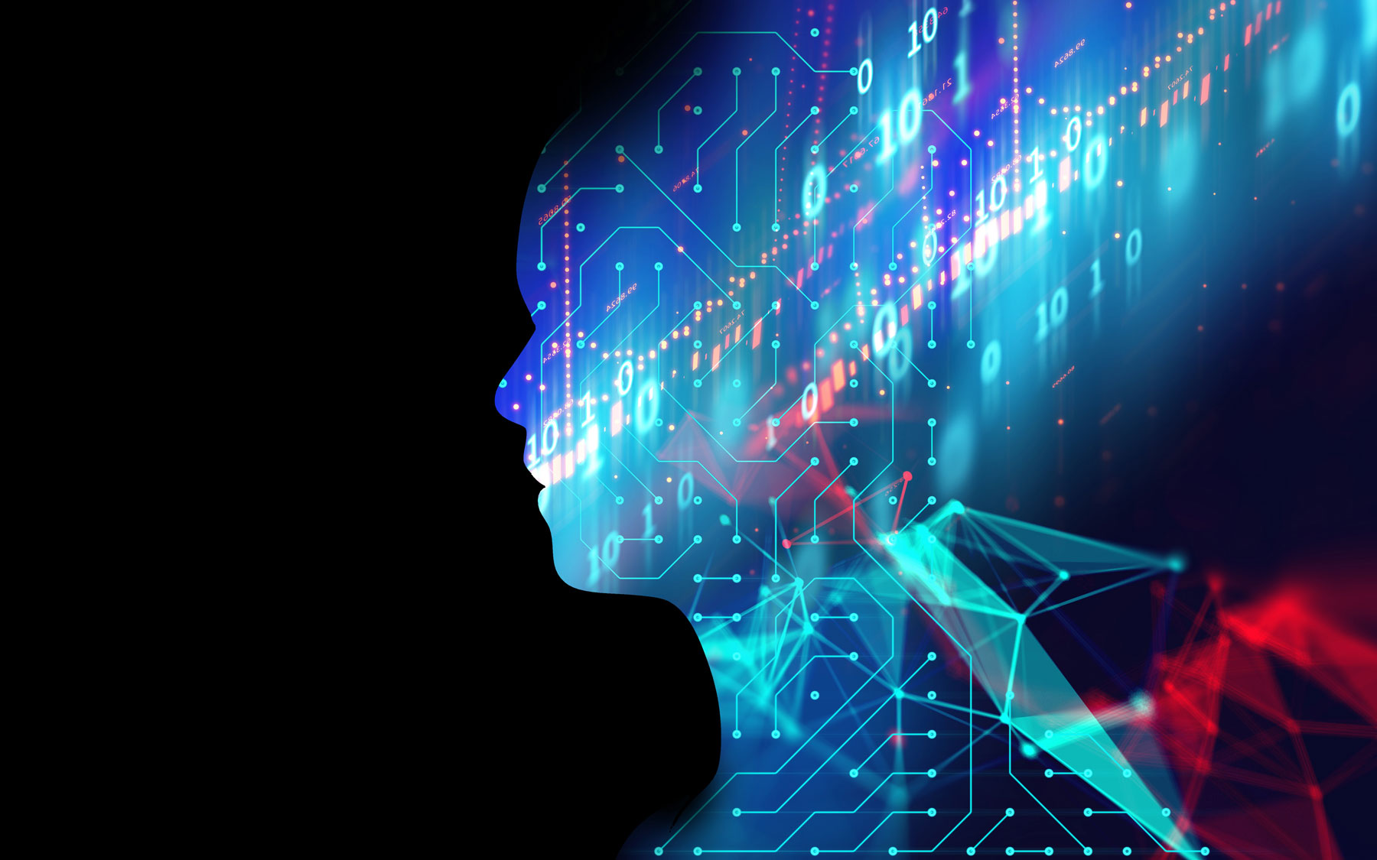
Final Project
Brian Jemison

Slide 2
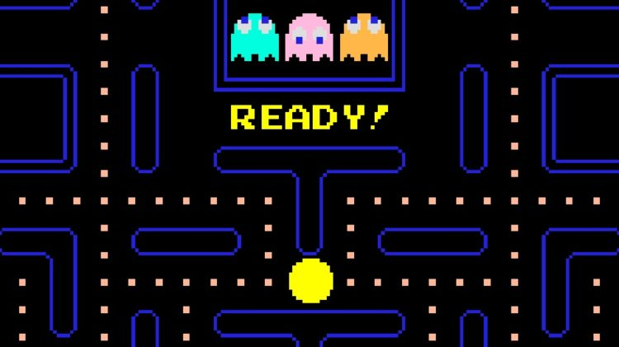
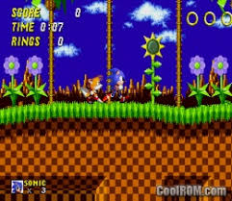
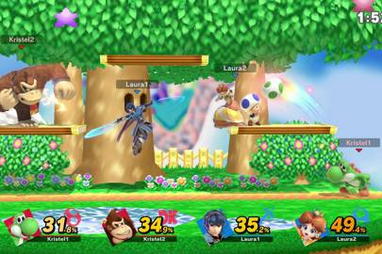
How does Artificial intelligence work in video games?

Slide 3

Most Video Games Don’t use Artificial Intelligence!

Slide 4
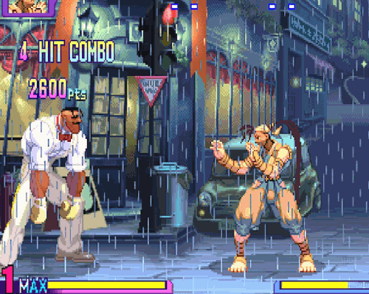
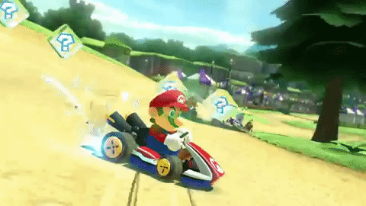
Most Games Use a Combination of If…Then statements to control npcs.
If Player 1 is in front of me….
Then attack Player 1.
If approaching curve in road…
Then turn.

Slide 5
What distinguishes good A.i. from bad a.i.?

Slide 6
Then how do npcs improve performance over time?

Slide 7
Rubberband Ai
The logic built within a video game that allows NPCs to ramp up their abilities to compete with those of the human character(s).

Slide 8
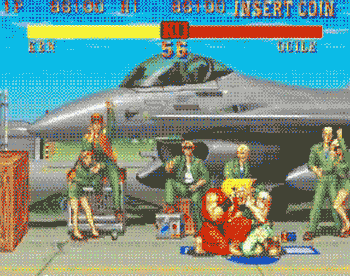
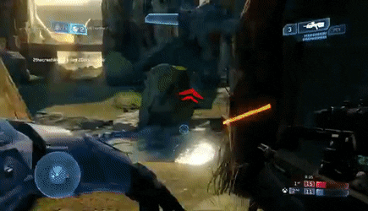
Dynamic game difficulty balancing
In-game logic built to determine the skill level of a human character and then offer a game experience to match.

Slide 9
Project scope
In Scope: To create an Artificial Intelligence which learns to play a video game on its own.
Not In Scope: Creating in-game script which instructs the A.I. on which action to taken and when to take the action.

Slide 10
Self-Driving Car

Slide 11
objective
Create a self-driving car A.I. that learns to drive on its own (only the inputs will be provided to the A.I.)

Slide 12
Q learning
Environment
State, Reward
Agent
Action

Slide 13
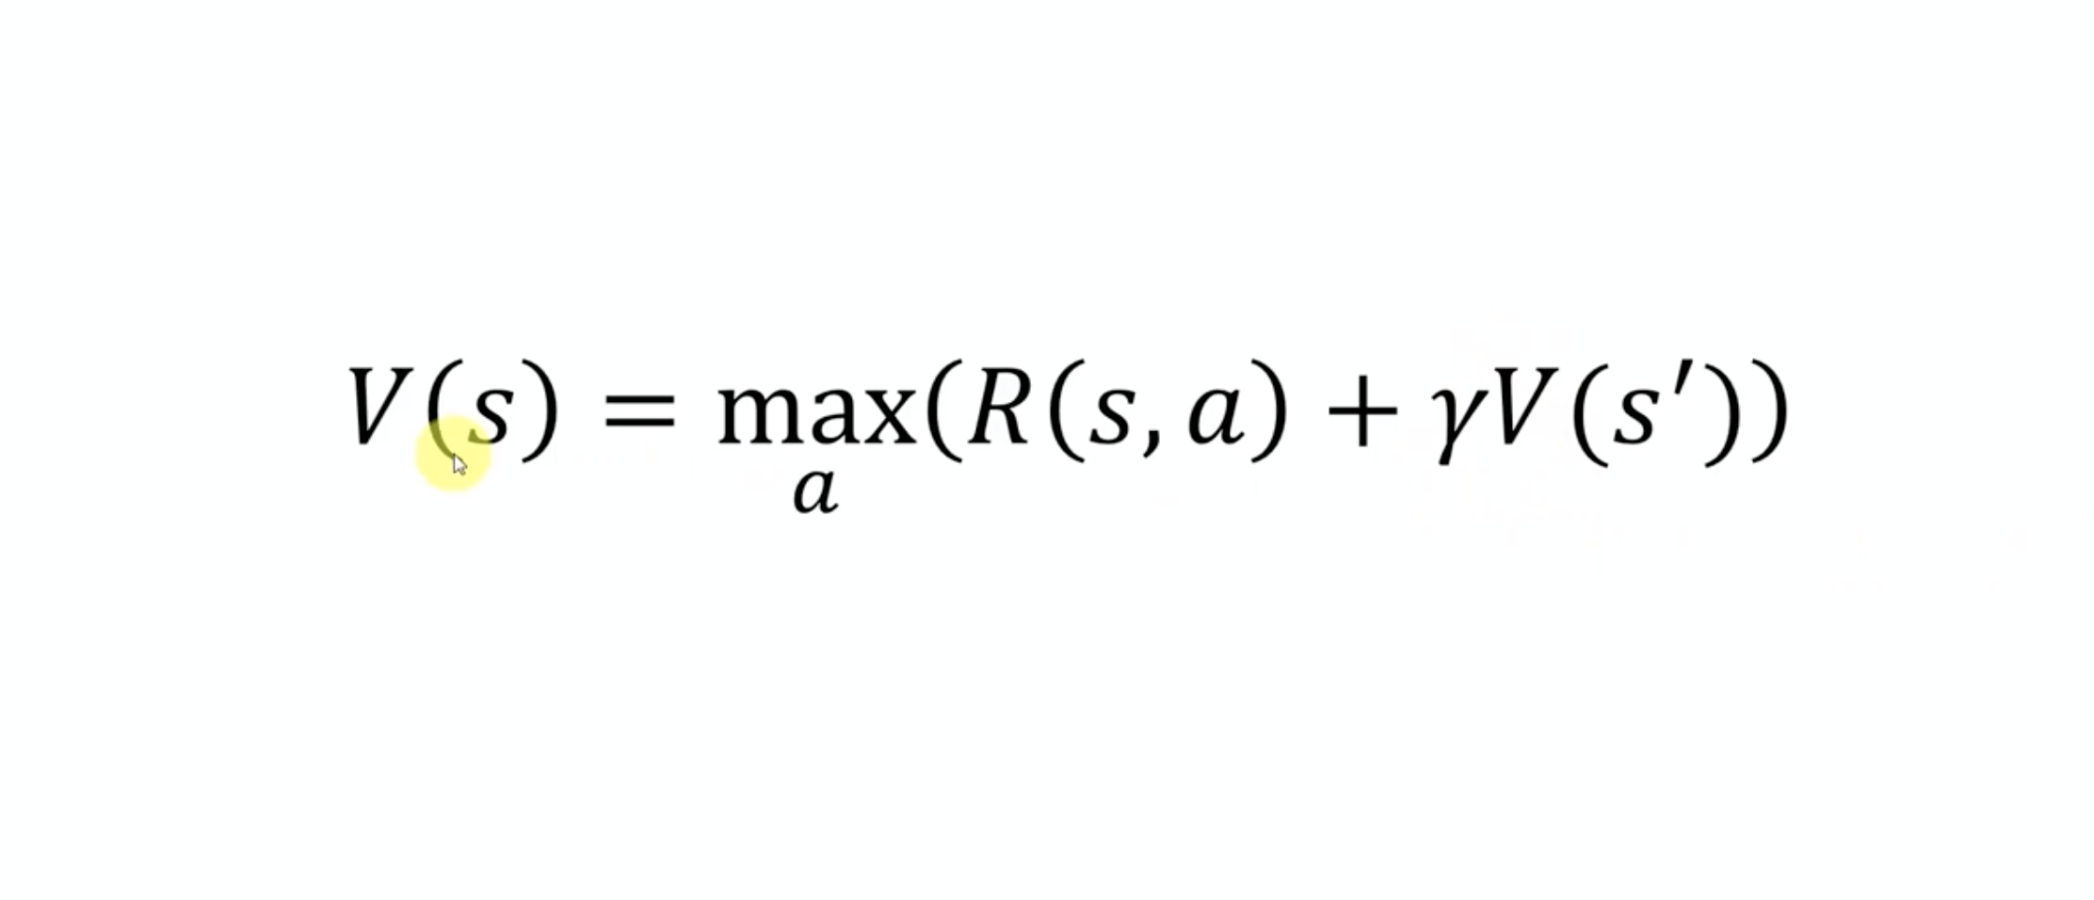
Bellman Equation

Slide 14
Building the game
3 possible inputs: Turn Left, Turn Right, Go Straight
Velocity is a constant
Three sensors on the front of the car to detect barriers
Barriers are defined as pixels on the screen.
The A.I. will travel to the top-left and bottom-right hand of the screen to reach its final reward (reward= +1).
Approaching the goal will result in + 0.1 Traveling further will result in -0.2
Driving over sand barriers will result in -2

Slide 15
Building the neural network
Passed into Input Layer : Signal 1, Signal 2, Signal 3, Orientation
Calculate loss (actual vs predicted)
Use Softmax as the Action Selection Policy (exploitation vs exploration)
Use Stochastic Gradient Descent for Back Propagation
Import the Neural Network in the Game Environment

Slide 16
Limitations
The neural network is highly limited in terms of the types of environments that it can be applied to
The neural network is incapable of ”seeing”

Slide 17
Breakout

Slide 18
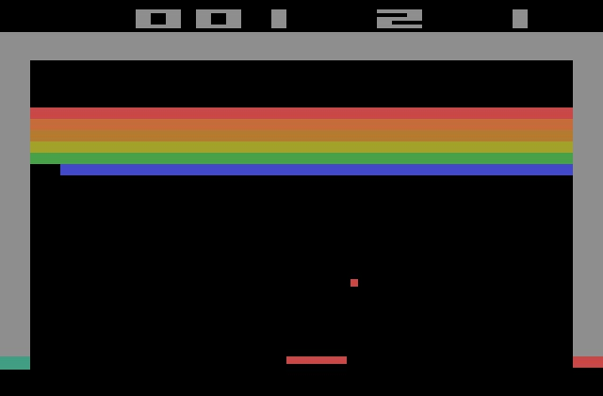
Objective
Create an Artificial Intelligence Neural Network which learns to play Breakout on its own and beat it.

Slide 19
CNN
Convolutional Neural Network
Gives the agent the ability to see similar to how humans do
Pooling
Flattening

Slide 20
A3C
Asynchronous Advantage Actor Critic
One of the most advanced algorithms for artificial intelligence
Developed my Google Deep Mind
Learns faster than other algorithms such as DQN
Uses multiple agents to run through the environment at different starting points so that they are all learning different aspects of said environment at the same time

Slide 21
LSTM
Long-Short Term Memory
Allows the agent to recall from learnings in previous iterations
Allows the agent to recall most recent event

Slide 22

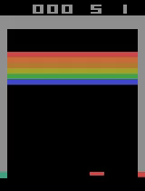
On the first epoch, the neural network took no action at all

Slide 23
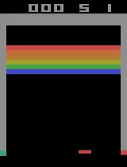

Slowly, the Neural Network began making moderate progress

Slide 24
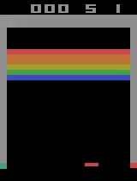
After numerous epochs, the neural network can better predict ball movement

Slide 25
Libraries
PyTorch
Numpy
Kivy
Random
Matplotlib
Gym

Slide 26
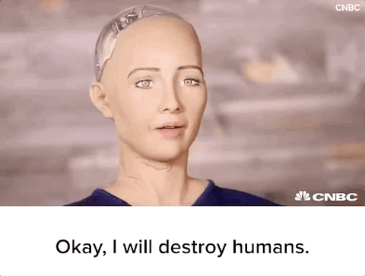
Questions?

